Slide 1

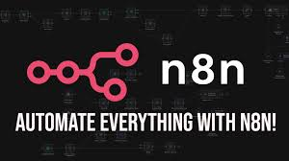
Smart Variance Reporting:
From Email Data to Actionable Insights
Presented by : Gowri Abbigeri
Tools: n8n | PostgreSQL

Slide 2
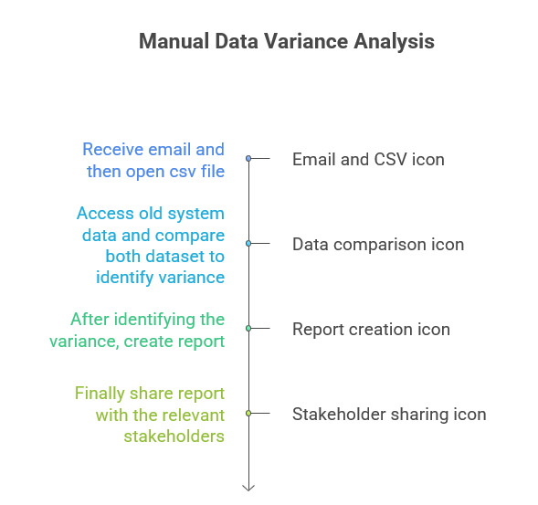

Slide 3
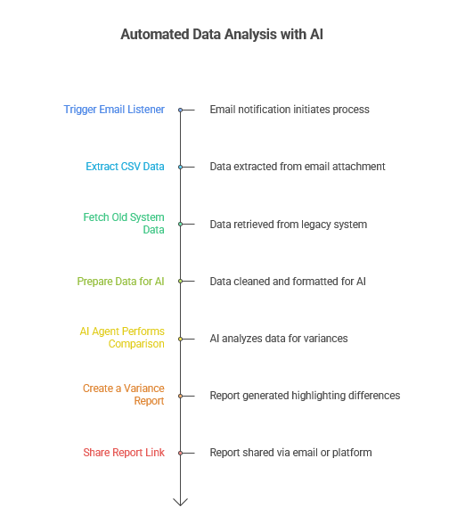

Slide 4
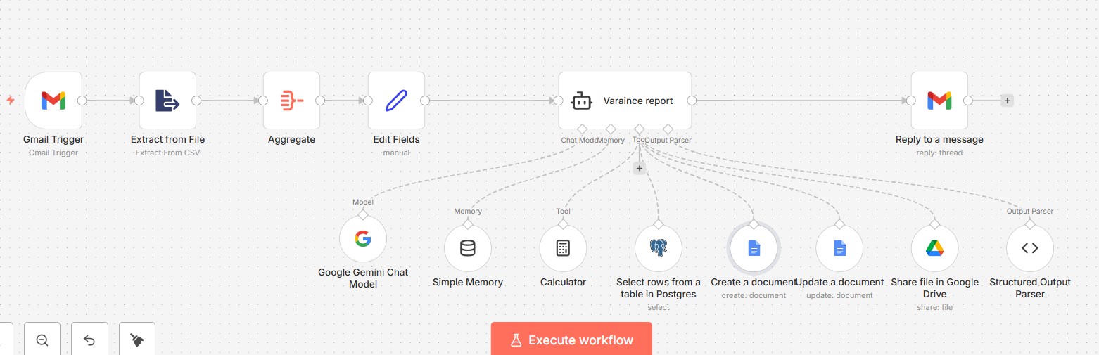
Workflow in n8n

Slide 5
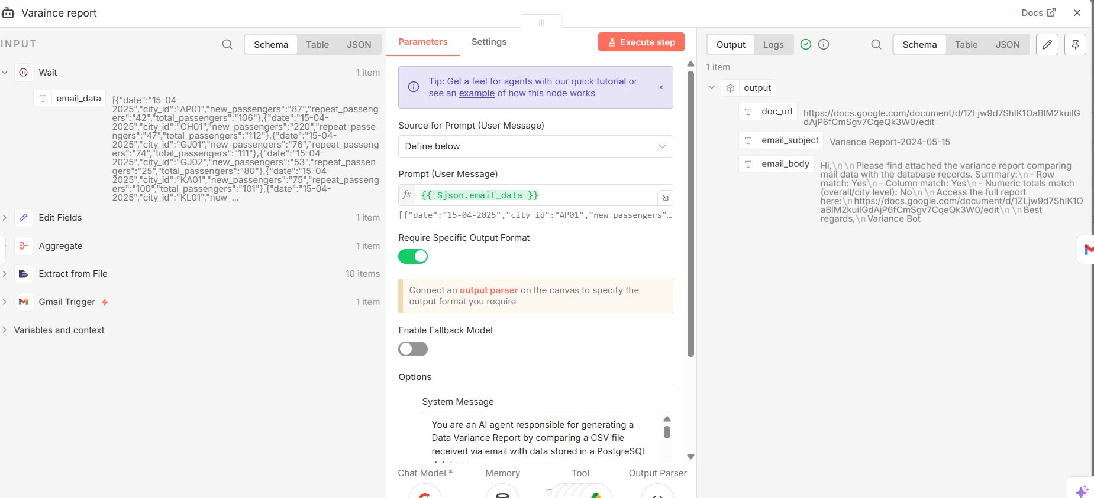
Output

Slide 6
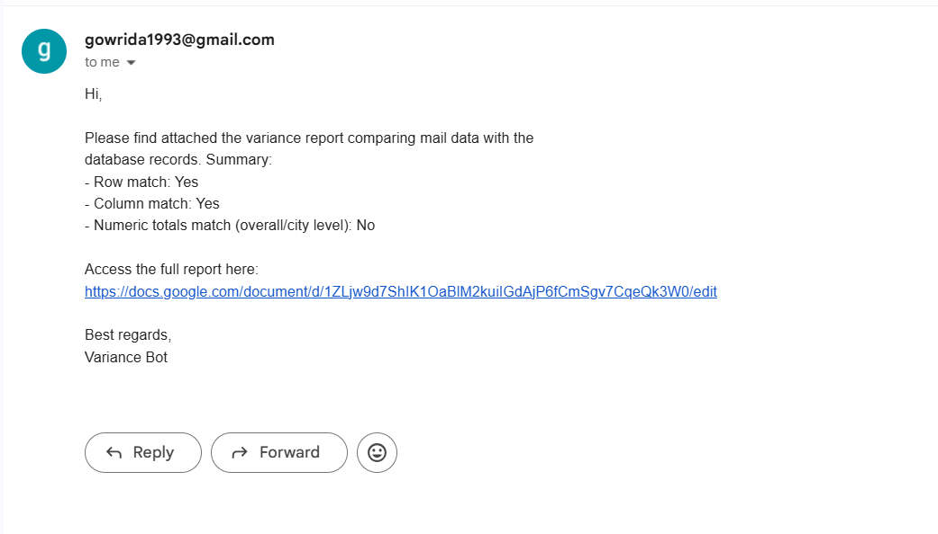
Email Output

Slide 7
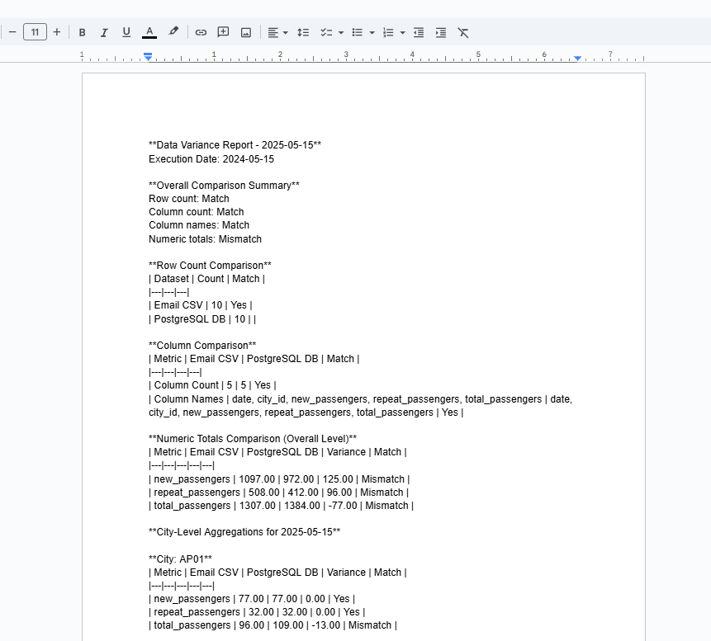
Output

Slide 8
Business Impact
This automation eliminates manual data validation, reduces human error, improves turnaround time, and ensures consistent reporting.
Saves hours of manual effort
Reduces data quality risks
Scalable for multiple datasets
AI-driven & future-ready

